Slide 1
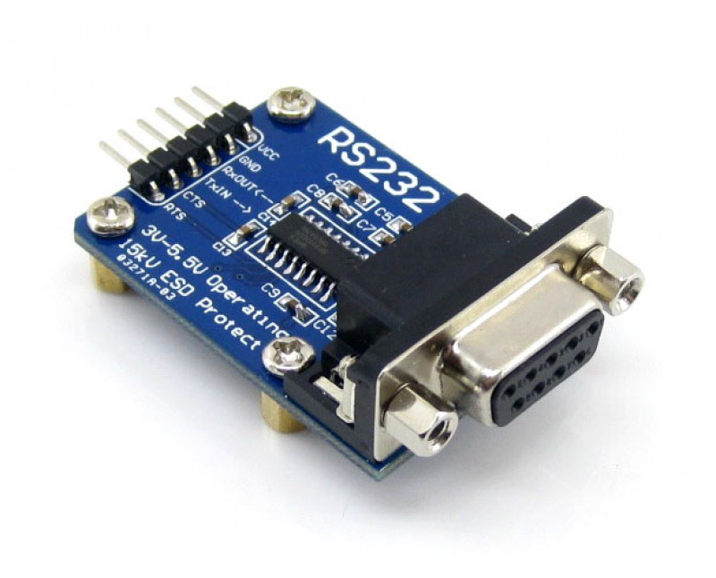
RS-232
Notes:
NOTE:
To change the image on this slide, select the picture and delete it. Then click the Pictures icon in the placeholder to insert your own image.

Slide 2
What is RS-232 ?
RS-232 (Recommended Standard 232).
It is basically a interface standards.
It is commonly used in computer serial ports.
The standard defines the electrical characteristics and timing of signals.
The current version of the standard is TIA-232-F ,issued in 1997.

Slide 3
History of RS-232
RS-232 was first introduced in 1962.
For many years, an RS-232-compatible port was a standard feature for serial communication.
The standard continued to be revised and updated by the Electronic Industries Alliance and since 1988 by the Telecommunications Industry Association (TIA).
The C revision of the standard was issued in August 1969.

Slide 4
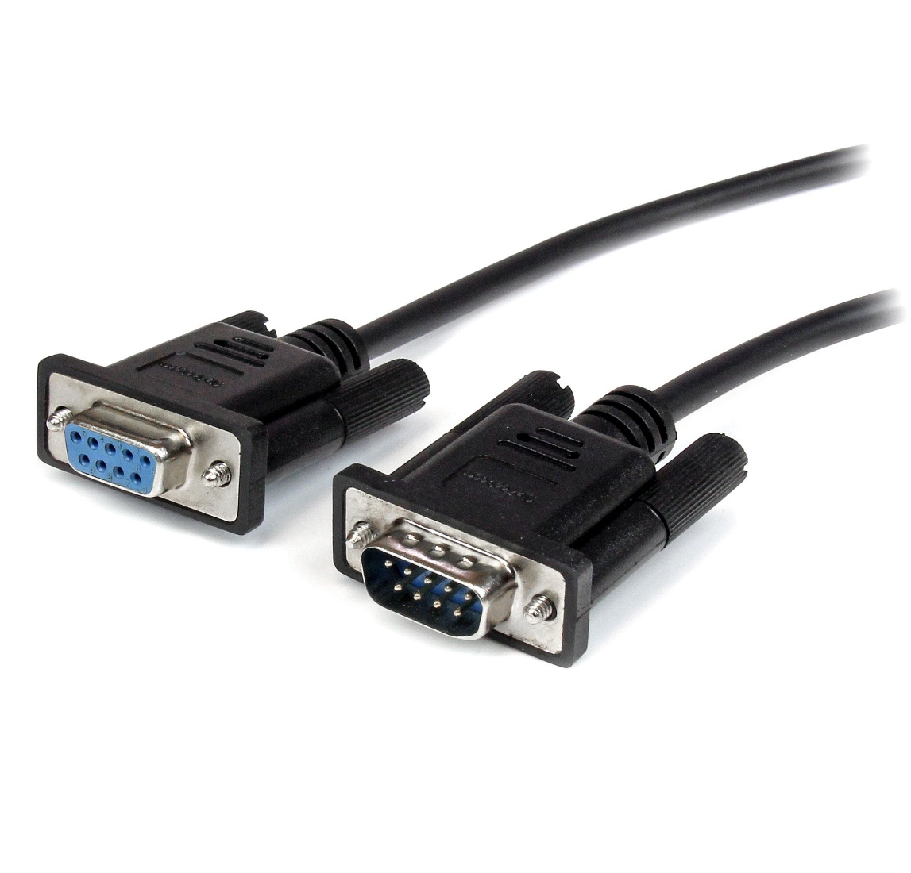
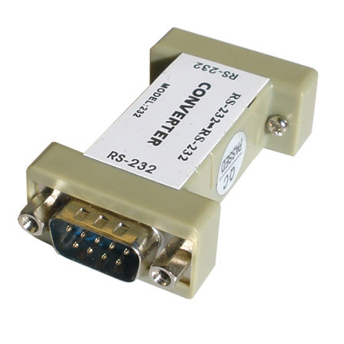
RS-232 Port

Slide 5
Architecture of RS-232
Architecturally RS-232 is a bi-directional point to point link.
Two independent channels are established for two-way (full duplex) communications.
RS-232 can also carry additional signals used for flow control (RTS, CTS) and modem control (DCD, DTR,DSR, RI).

Slide 6
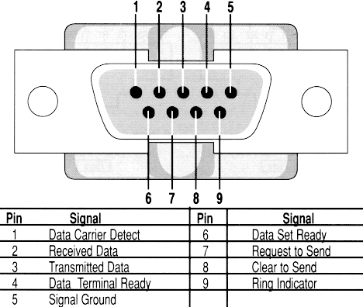
RS-232 Pin Diagram

Slide 7
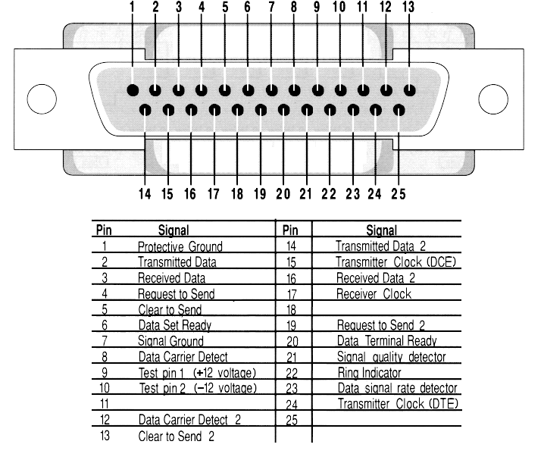
25 Pin RS-232 Connector

Slide 8
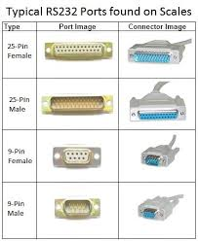
Typical RS-232 Ports

Slide 9
Use of RS-232
RS232 cable is used for serial communication between computer and other equipment's such as:
1. modem
2. printer
3. scanner
4. other electronics systems not in category of computer peripherals
5. PLC
6. Low end Embedded systems development kits etc.

Slide 10
Limitation of RS-232
The limited transmission speed, relatively large voltage swing, and large standard connectors motivated development of the universal serial bus(USB) which has displaced RS-232.
Multi-drop connection among more than two devices is not defined.
Also multi-drop have limitations in speed and compatibility.

Slide 11


